Slide 1

Problem statement:
Global Insure, a leading insurance company, processes thousands of claims annually. However, a significant percentage of these claims turn out to be fraudulent, resulting in considerable financial losses. The company’s current process for identifying fraudulent claims involves manual inspections, which is time-consuming and inefficient. Fraudulent claims are often detected too late in the process, after the company has already paid out significant amounts. Global Insure wants to improve its fraud detection process using data-driven insights to classify claims as fraudulent or legitimate early in the approval process. This would minimise financial losses and optimise the overall claims handling process.

Slide 2
Understanding the Rise of Insurance Fraud in Rural India
When we think about money fraud, we usually imagine smart people in big cities using computers and the internet to trick others. But when it comes to insurance fraud, the reality is quite different. Surprisingly, rural areas in India have seen a major spike in fraudulent claims over the past decade and it’s becoming a serious problem.

Slide 3
Insurers have discovered well-organized groups operating in these regions almost like companies with trained people collecting information, forging documents, and filing fake claims. These fraud rings often target families of people who are critically ill or near death, making it easier to fake life or health claims. On top of that, the lack of strict checks when policies are issued makes it easier for such fraud to slip through the cracks.
To fight this, we need more than just basic checks. Insurance companies must start using technology like AI and machine learning to catch suspicious patterns early. At the same time, there’s a need for stricter punishments under the law, and a central database of known fraudsters to prevent repeat offenses. Without strong action and better systems in place, rural insurance fraud may continue to grow causing huge losses and eroding trust in the system.

Slide 4
Objective:
●Move beyond traditional, rule-based fraud detection methods used in insurance.
●Build a data-driven model using historical claims data to detect fraud automatically.
●Use machine learning algorithms (like Random Forest and Logistic Regression) to classify claims as fraudulent or legitimate.
●Identify complex fraud patterns that manual checklists or fixed rules often miss.
●Enable early fraud detection to prevent financial losses and speed up decision-making.
●Support insurers in making smarter, more accurate claim approvals with less manual effort.

Slide 5
Libraries used:
1) warnings
2) numpy
3) pandas
4) seaborn
5) matplotlib.pyplot
6) sklearn (specifically sklearn.model_selection, sklearn.metrics, sklearn.ensemble)
7) imblearn.over_sampling
8) statsmodels.api
9) statsmodels.stats.outliers_influence
10) sklearn.preprocessing

Slide 6
Algorithms used:
Algorithms that are used:
1)Random forest
2) logistic regression

Slide 7
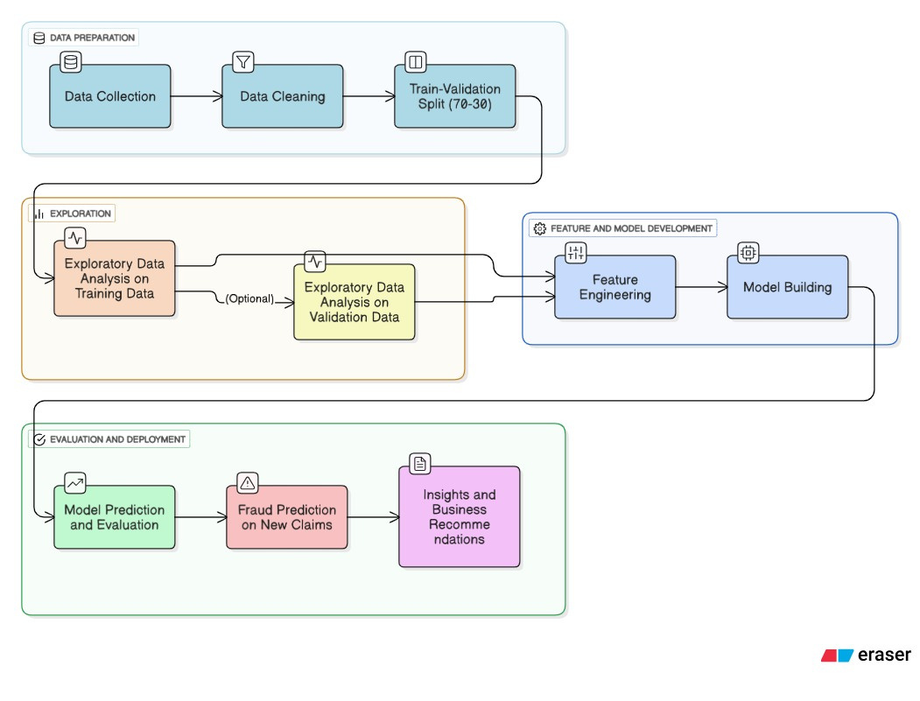

Slide 8
DESIGN AND ROADMAP:
The data contains the following attributes:
Features:
Customer & Policy Details
●months_as_customer: Number of months the customer has been with the insurance company.
●age: Age of the insured person.
●policy_number: Unique identifier for each insurance policy.

Slide 9
●number_of_vehicles_involved: Number of vehicles in the incident.
●property_damage: Whether property was damaged.
●bodily_injuries: Number of bodily injuries.
●witnesses: Count of people who witnessed the event.
●police_report_available: Whether a police report was filed.
Claim Amounts
●total_claim_amount: Total amount claimed.
●injury_claim: Amount claimed for injuries.
●property_claim: Amount claimed for property damage.

Slide 10
●vehicle_claim: Amount claimed for vehicle repair/replacement.
Vehicle Information
●auto_make: Car manufacturer (e.g., Honda, Ford).
●auto_model: Specific model of the car.
●auto_year: Year of car manufacture.
Target Variable
●fraud_reported: Indicates if the claim is fraudulent (Y) or not (N).

